Slide 1
Digital technology
Introduction – Why do we need digital technology ?
Jari Hautamäki

Slide 2
Analog vs. digital
Generally, signals are analog when it describes the phenomenon to be measured straight/directly
Vocal cords form sound waves
The sound waves move in the air to the listener
The listener's eardrums vibrate/oscillate
The vibration is understood as speech
Signal is digital when the information within is coded according to some system

Slide 3
Analog vs. Digital
Electronics usually classifies a signal as analog when it has an acceptable value in all states
If the voltage values of the signal indicated in red are acceptable at every moment, the signal is analog
If the voltaga values of the signal inidicated in red are acceptable only at certain voltage values, the signal is not analog!
For a signal to be classified as analog we need to know the use of the signal.

Slide 4
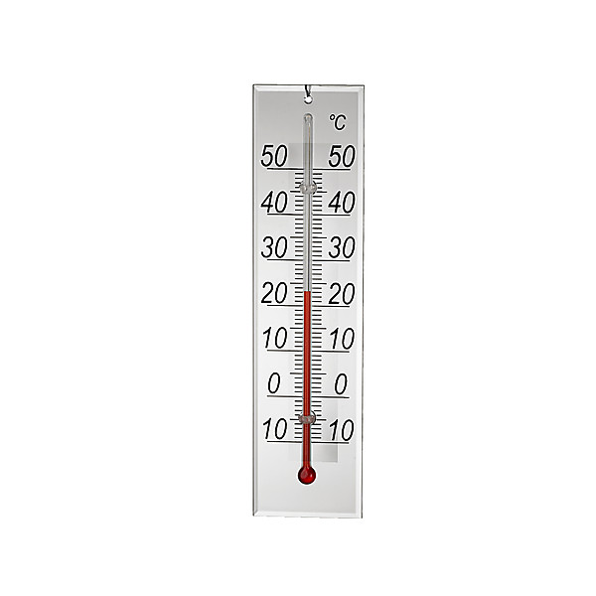
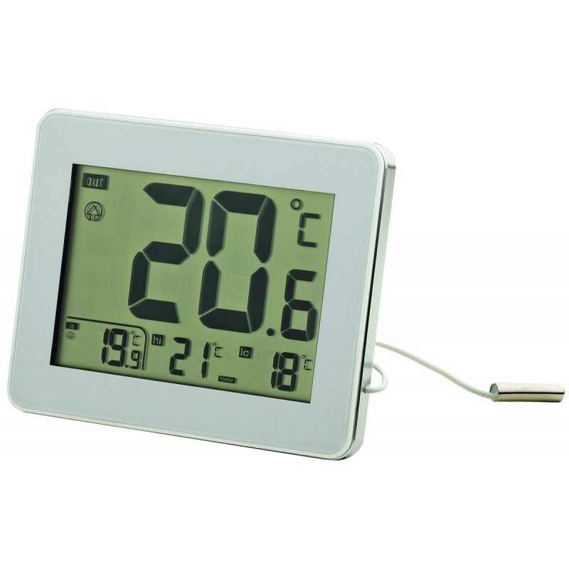
Representation forms of information
The measurable variables in the nature are analog:
Temperature, sound, humidity, wind speed, water flow, …
E.g.
An analog thermometer presents all possible values, e.g. 22,567... degrees
With a digital meter this reading can be presented with a limited accuracy
With digital information the unit is a bit. One bit has the values 1 and 0.
The value 1 is usually agreed to be HIGH(5V) and value 0 is LOW(0V).
If more values need to be expressed several bits are needed
Computer handles digital information
A conversion is needed from analog to digital and (vice versa)

Slide 5
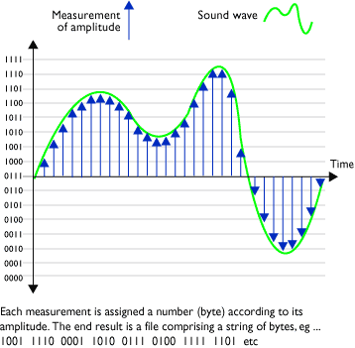
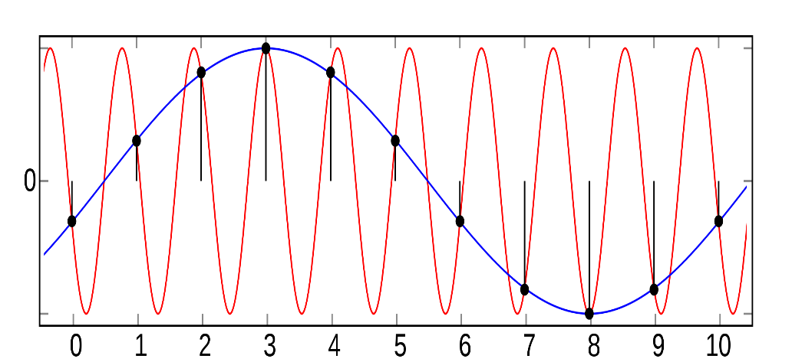
Analog-digital conversion
AD_conversion stages:
The filtering of signal from sensor (prevents aliasing and noise)
Samples must be taken at least double the amount compared to the signal frequency (too few samples cause aliasing. In the figure, the blue signal is aliased. Where have you seen an aliased signal?
In practice, we always need to know the signal frequency range and select devices based on this. .

